Slide 1
PSY 1406: Primate FaceNet Detection
Group Members: Andrew Byun, Julia Casas, Ethan McFarlin, and Claire Suen

Slide 2
Research Questions
- How does FaceNet perform on non-human face recognition tasks?
- What role do gender and age play in FaceNet’s detection capabilities?
- Can FaceNet help us gain insight into visual indicators of evolutionary similarity?
- Does FaceNet prove useful in differentiating between species?

Slide 3
Hypothesis
While FaceNet will be able to distinguish between individual chimps (by some statistically significant margin), it will struggle with more advanced face recognition tasks along the axes of gender, age, and interspecies identification.
To test this theory, we will pass input images from annotated datasets of chimps, rhesus macaques, and Japanese Monkeys into FaceNet and compute statistical analysis on the euclidean distance scores.
We will break this analysis into 4 questions and carry out independent euclidean distance computations for each of them.

Slide 4
Question 1
Can FaceNet identify individual chimps?

Slide 5
Dataset and Wrangling
Name: Alexander Freytag and Erik Rodner and Marcel Simon and Alexander Loos and Hjalmar Kühl and Joachim Denzler: "Chimpanzee Faces in the Wild: Log-Euclidean CNNs for Predicting Identities and Attributes of Primates", German Conference on Pattern Recognition (GCPR), 2016.
Cleaned Data: 50 chimp images. Half of the images are of the same chimp named ‘Fredy’. The other half of the images depict different chimps.

Slide 6
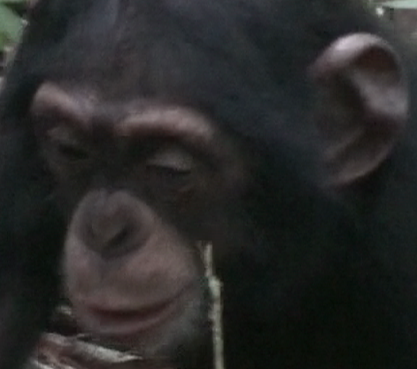
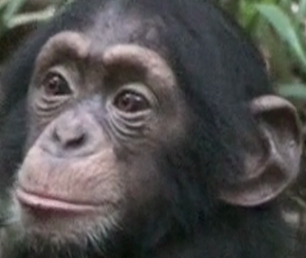
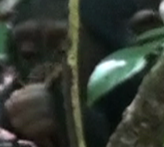
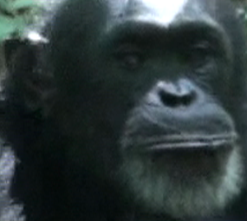
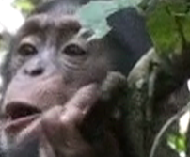
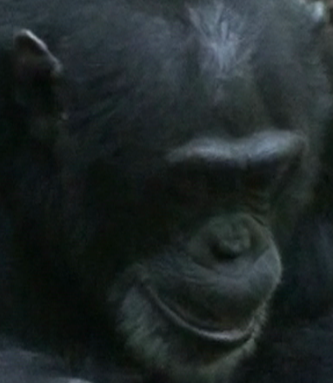
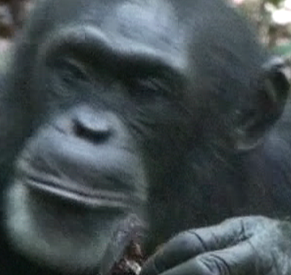
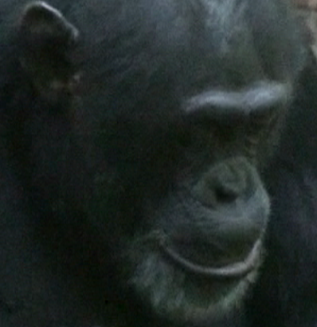
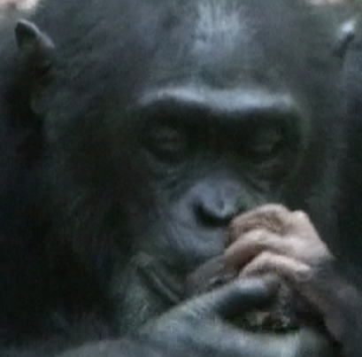
Negative/Positive/Anchor Images
Positive: 49 Other Fredy Images
Negative: 50 Non-Fredy
Chimp Images
Anchor: Fredy
(Image ID #54)

Slide 7
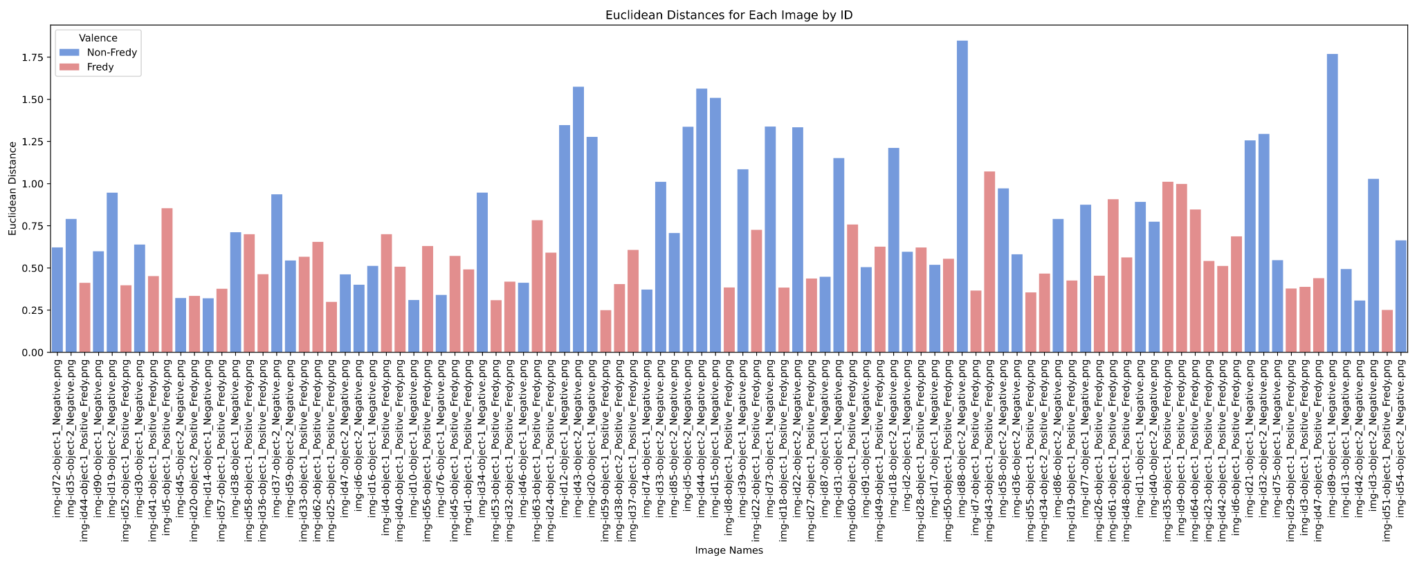
Notes:
Fredy ID: -4.629450042388837 1.1372165432910855e-05

Slide 8
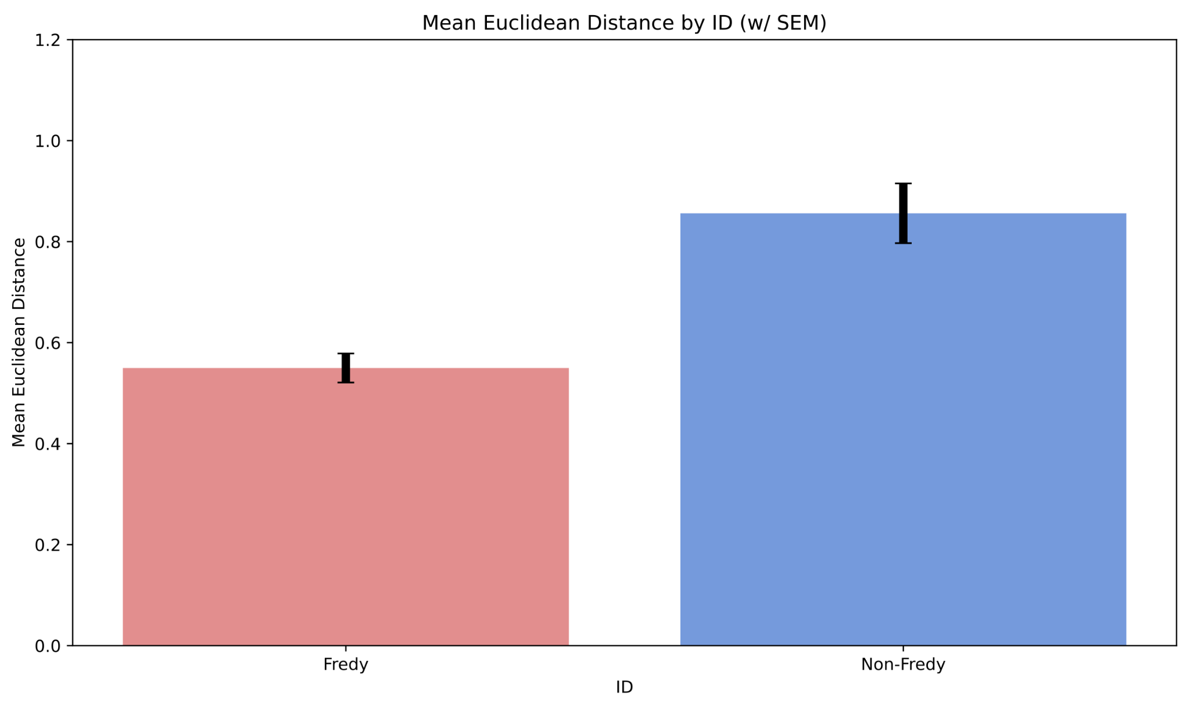
P < 2e-5

Slide 9
Question 2
Can FaceNet discriminate between gender within species?

Slide 10
Description of Dataset (Question 2-4)
Name: PrimFace (Face database of non-human primates)
https://visiome.neuroinf.jp/primface/
Primate Types: Japanese Monkey, Rhesus Macaque, Chimpanzee with metadata on gender and age
30 Images of n=3 for each of the primate types were used

Slide 11
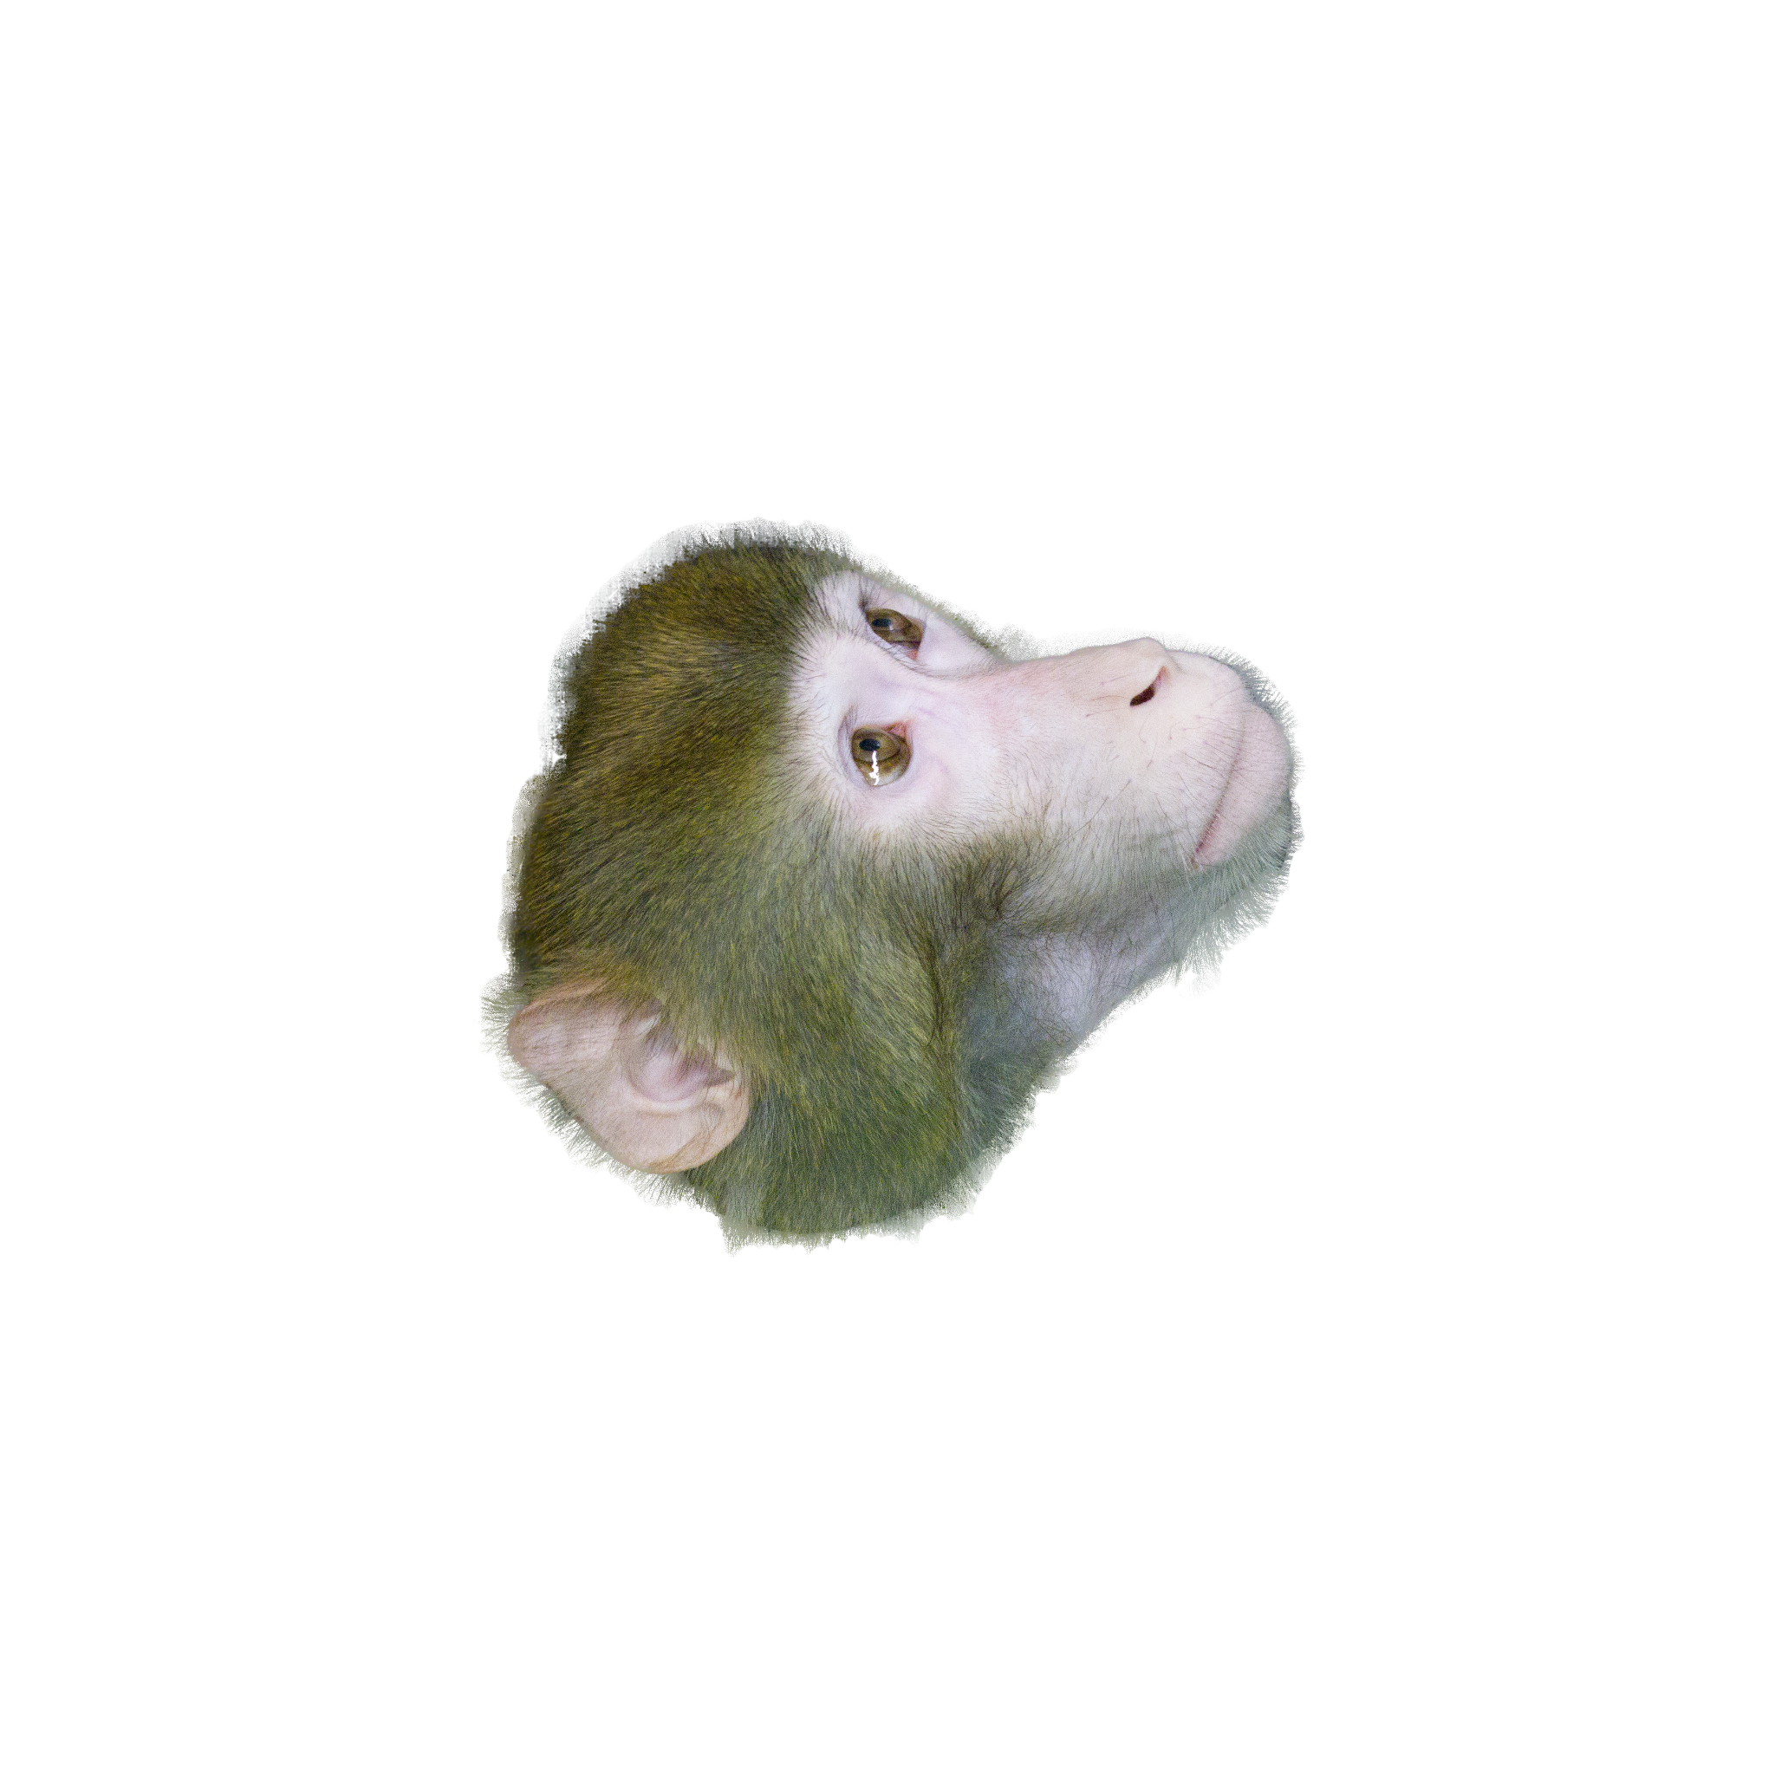
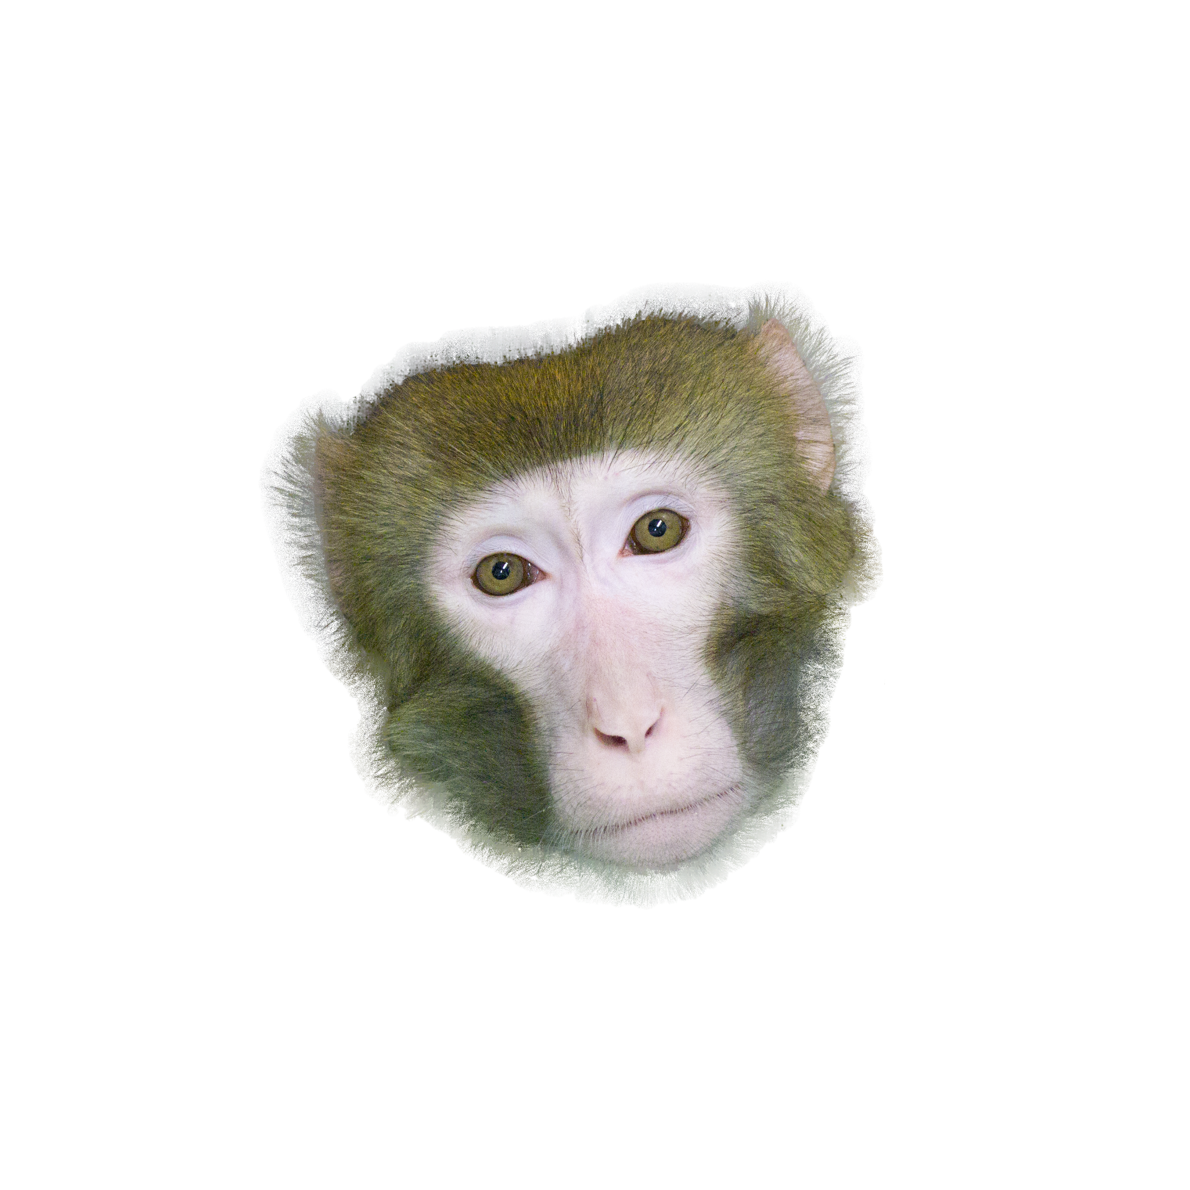
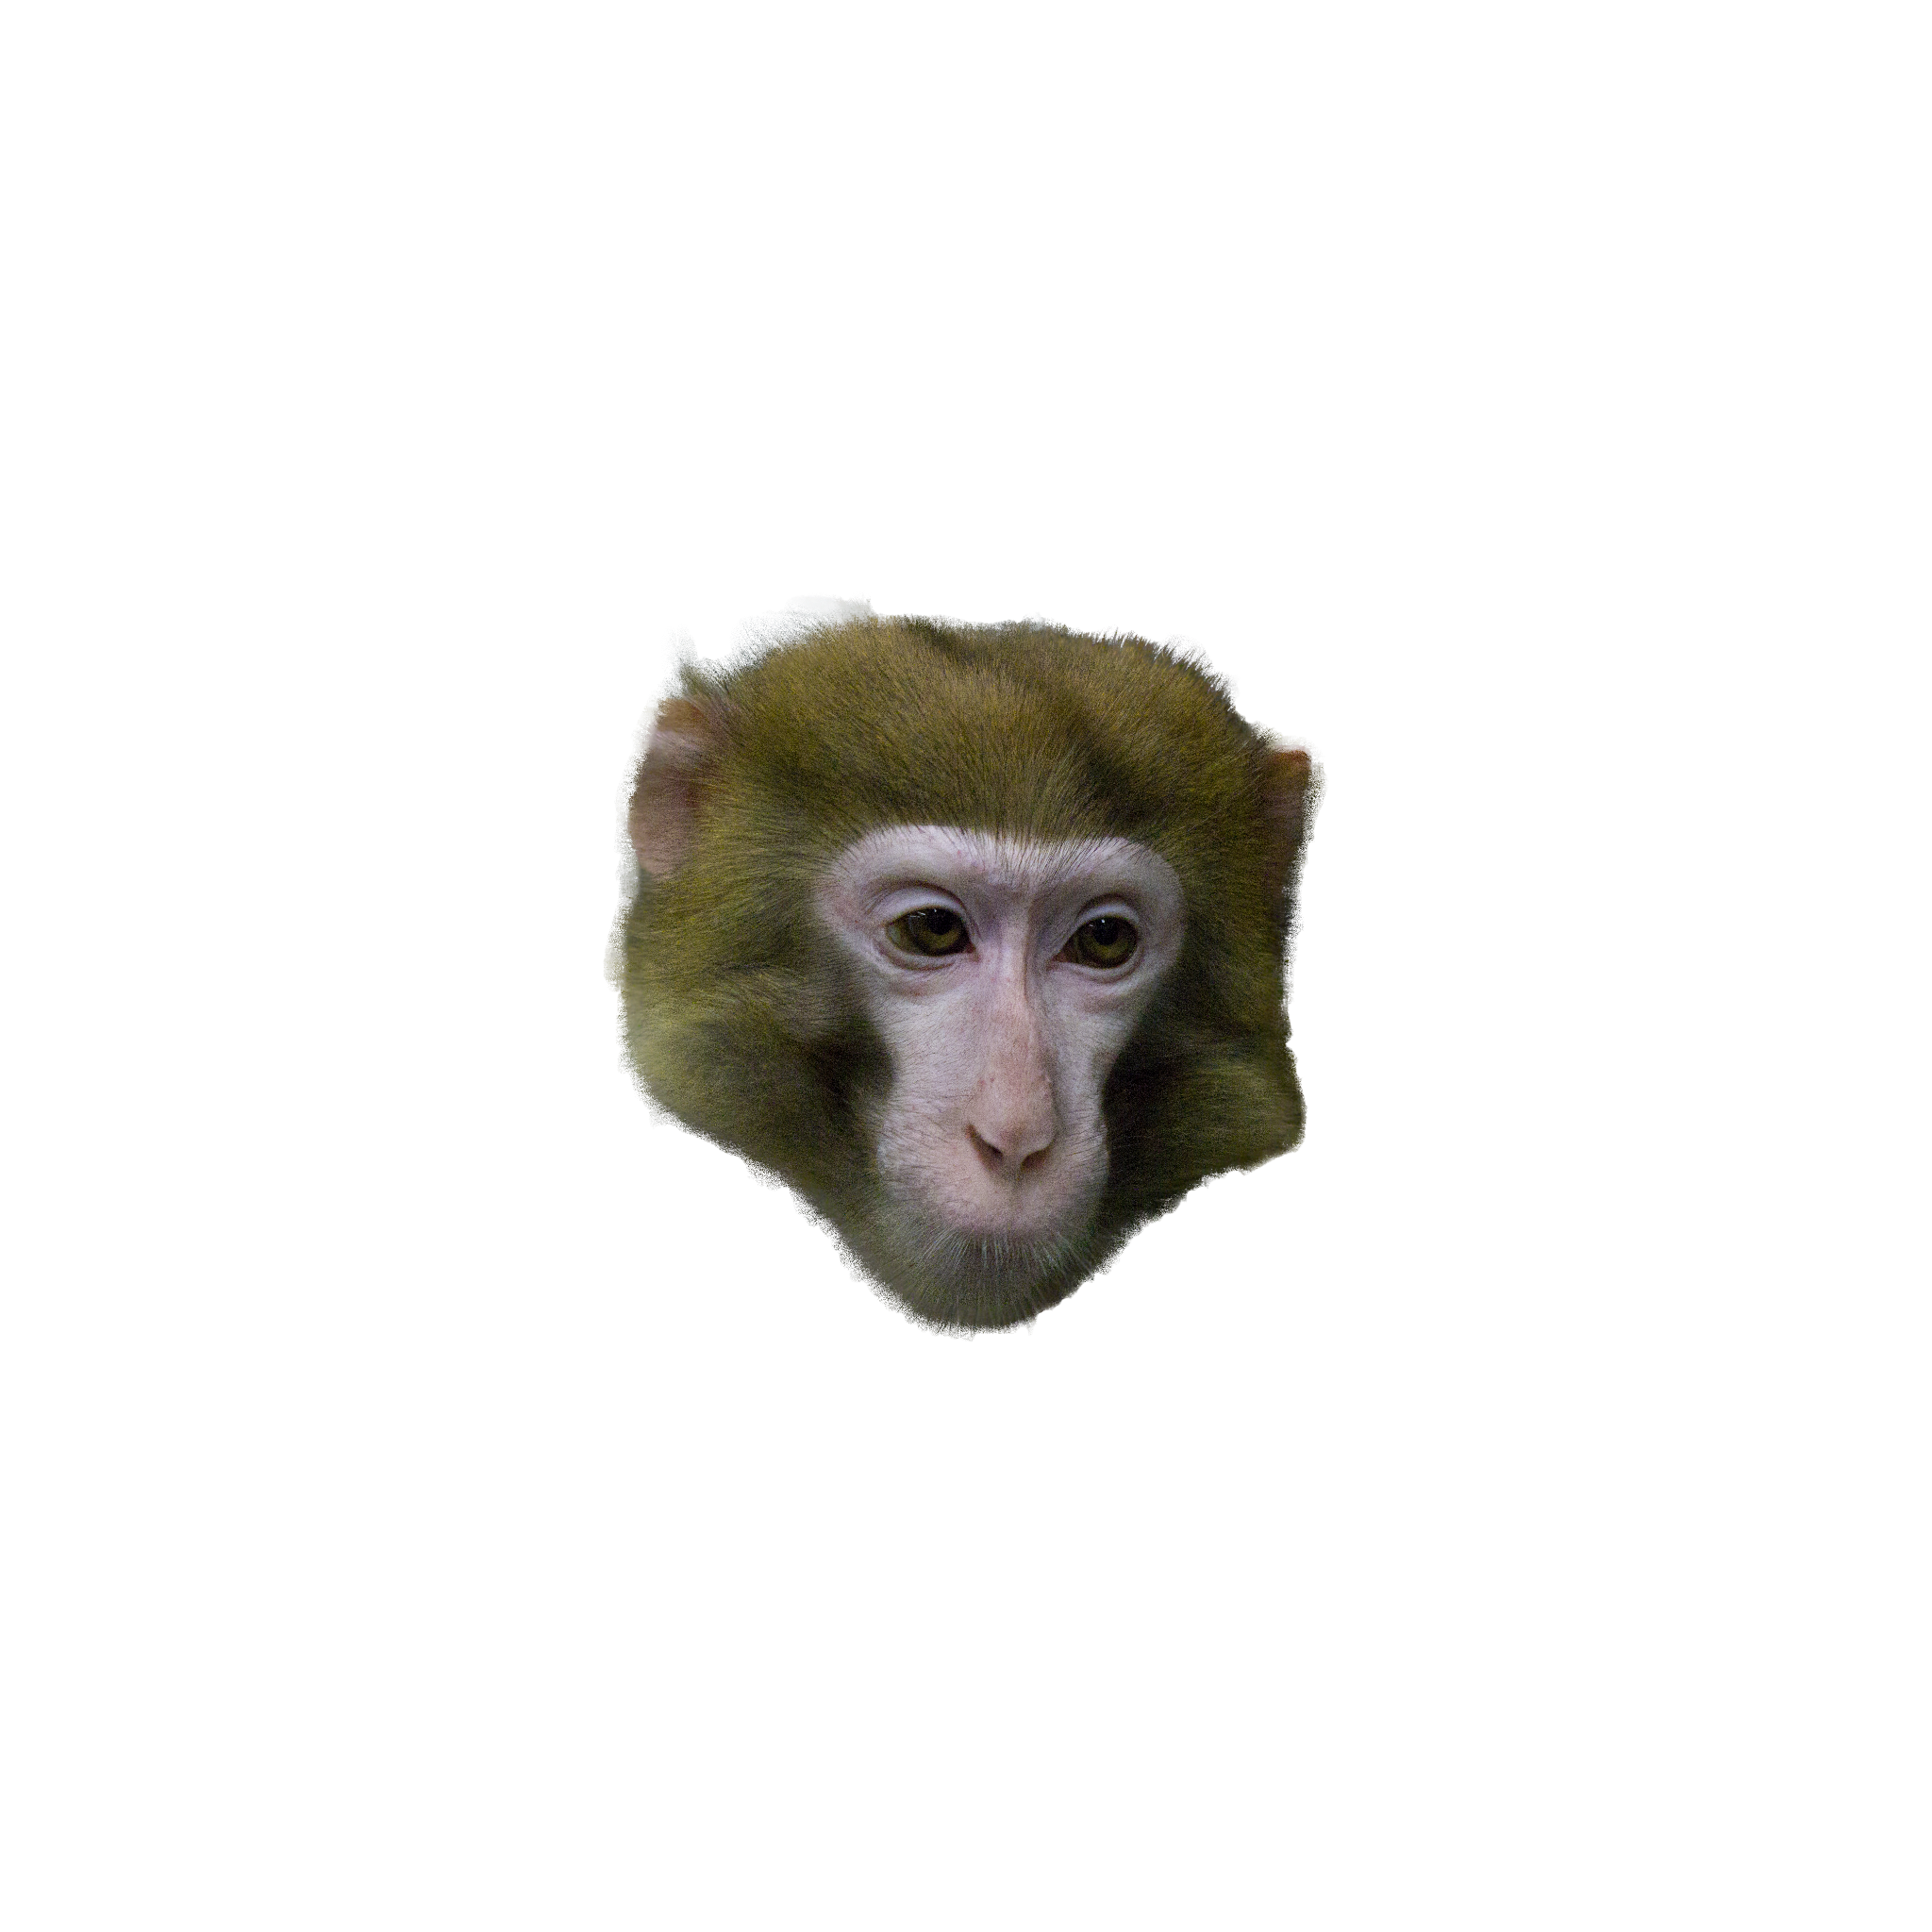
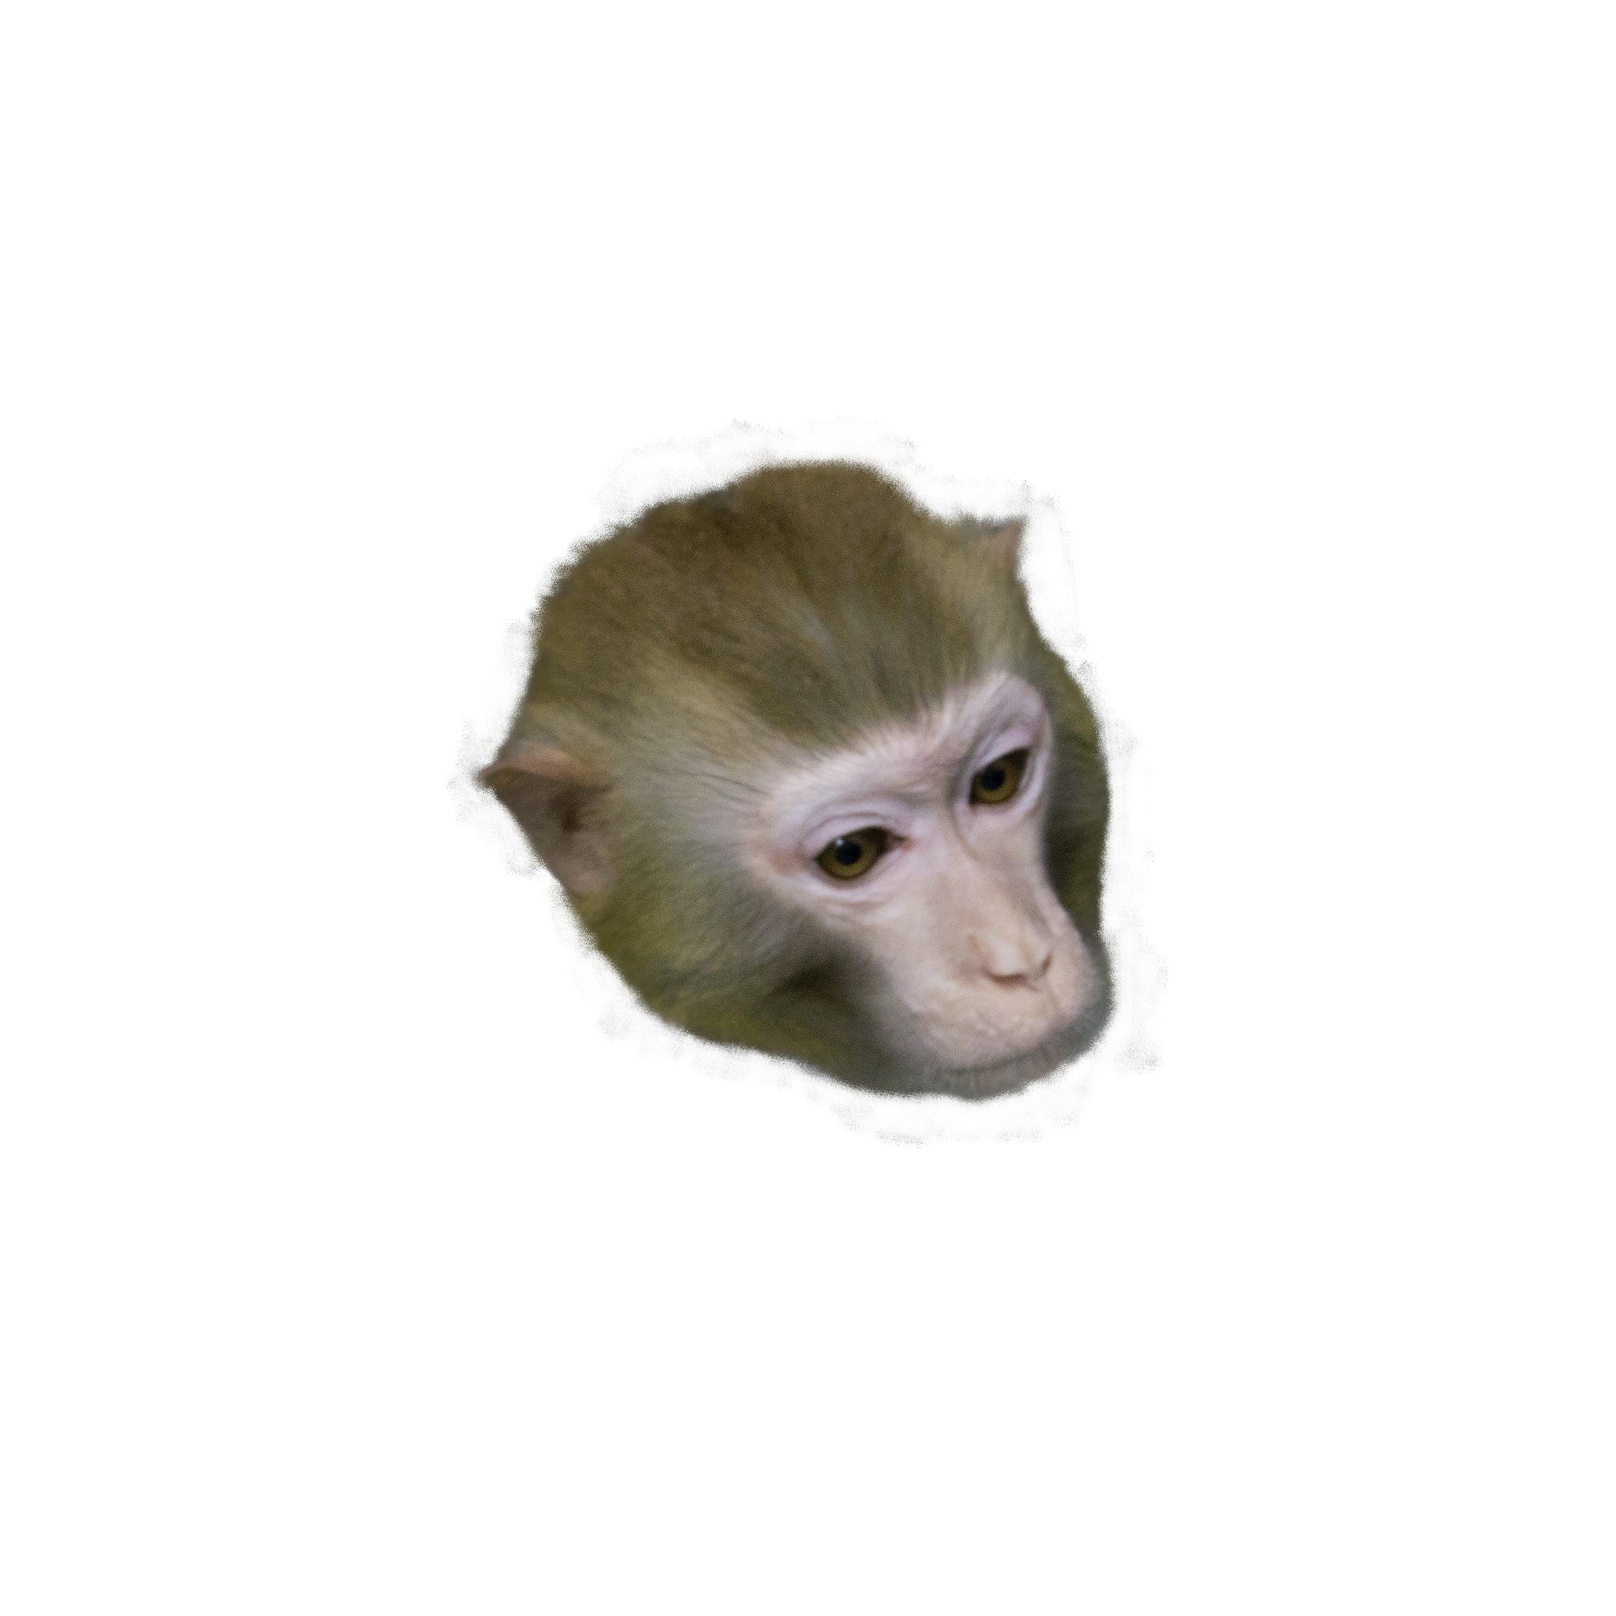
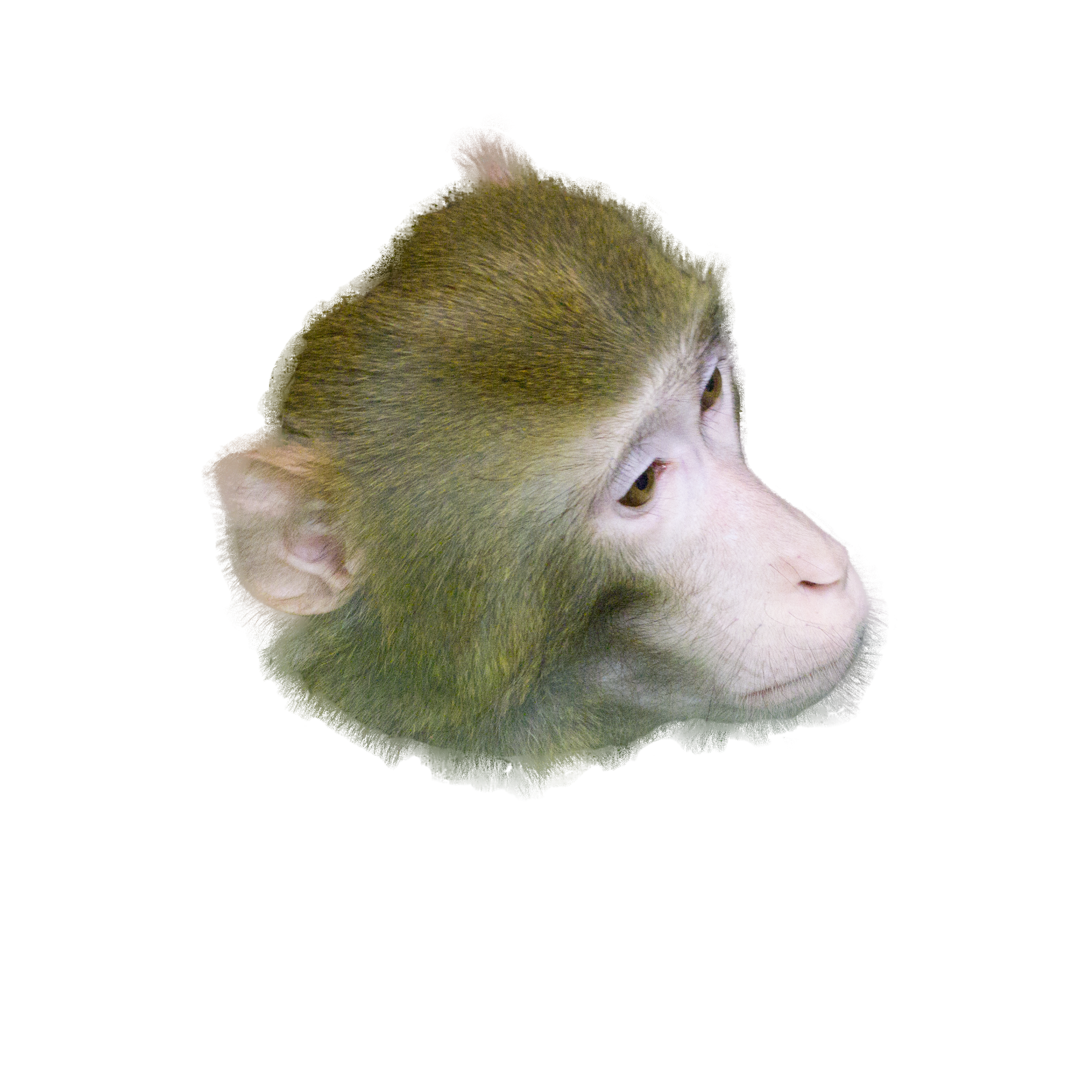
Negative/Positive/Anchor Images
Anchor:
Rhesus Macaque
(Female/Age:5)
Positive:
Rhesus Macaque
(Female/Age:5)
Different angled images
Negative:
Rhesus Macaque
(Female/Age:20)
Rhesus Macaque
(Male/Age:5)
This design allows us to investigate discriminative capacity of FaceNet on Rhesus Macaque gender, but also Age (Question 3)

Slide 12
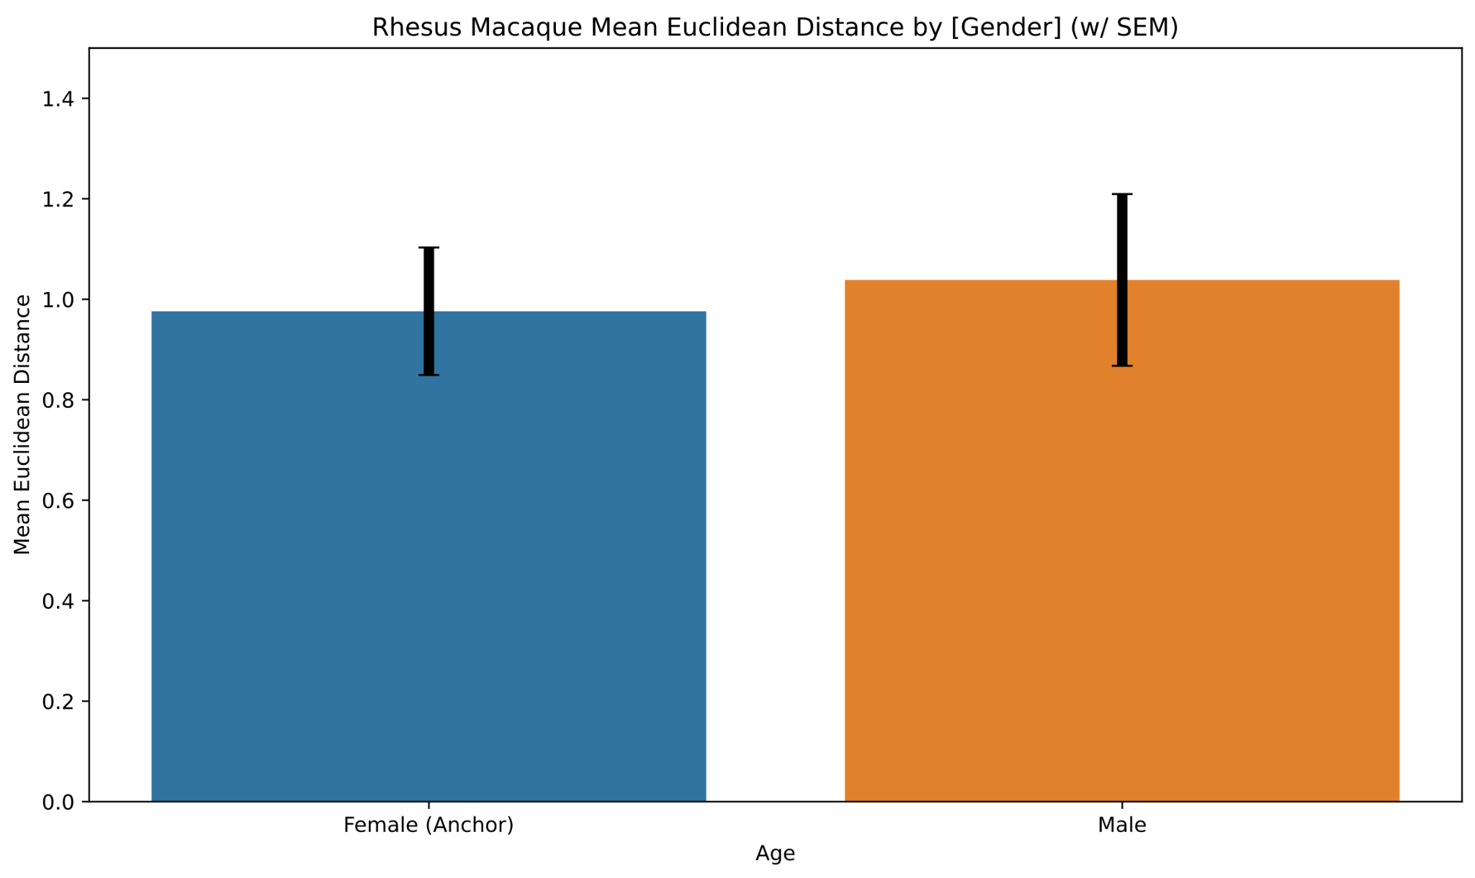
NS

Slide 13
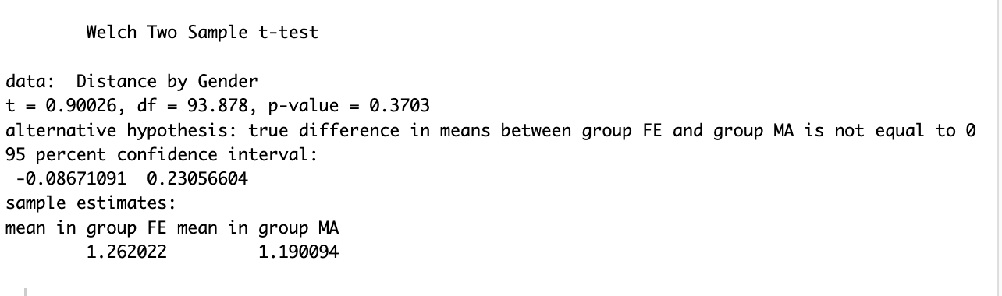
Can Facenet recognize males more accurately than females?

Slide 14
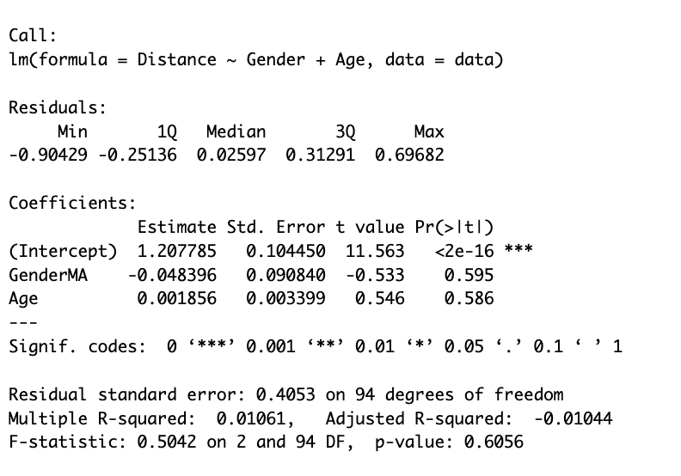
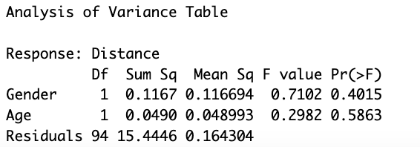
Can Facenet recognize males more accurately than females, controlling for age?

Slide 15
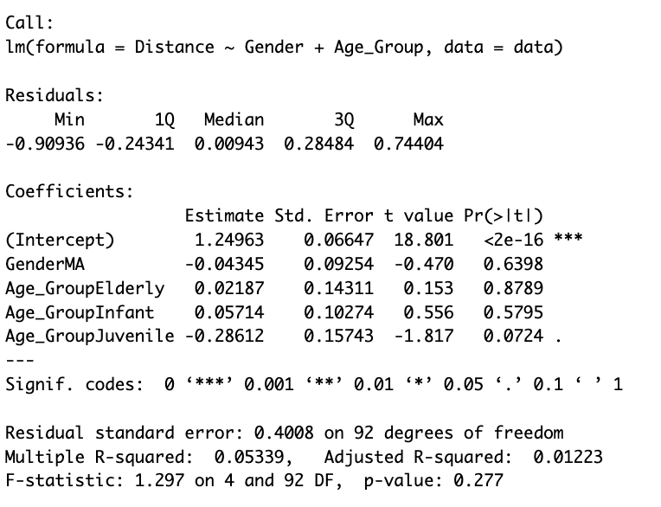
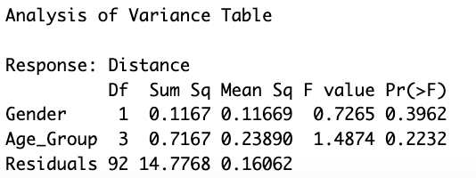
Can Facenet recognize males more accurately than females, controlling for age groups?

Slide 16
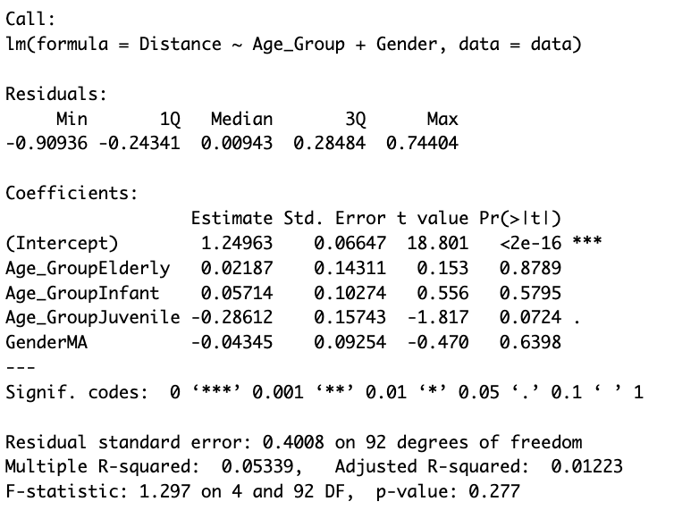
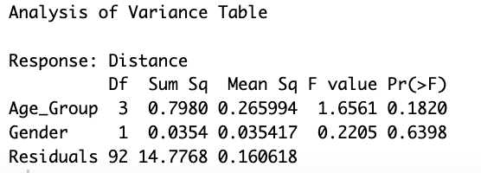
Exploratory Analysis: Can we predict euclidean distance based on age group while controlling for gender?

Slide 17
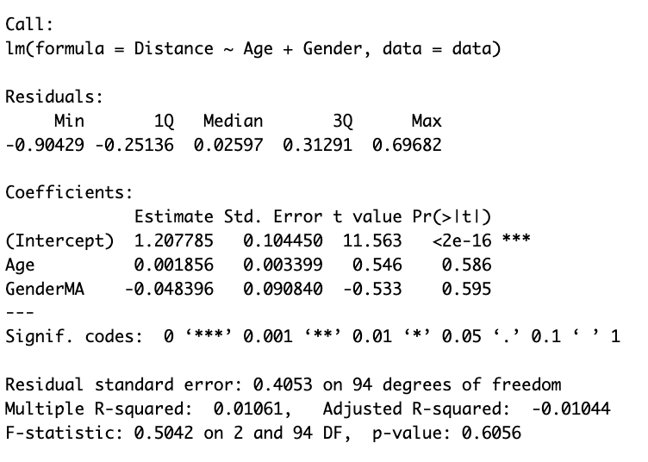
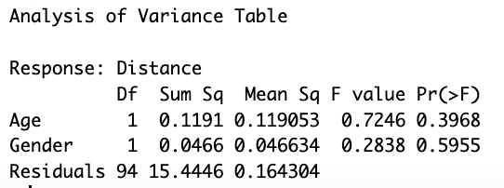
Exploratory Analysis: Can we predict euclidean distance based on age group while controlling for gender?

Slide 18
Discussion (Broad)
Facenet’s sensitivity to Chimp faces:
Training data bias
Feature emphasis discrepancy: Facenet is trained to emphasize and distinguish among human faces (eye spacing, facial symmetry, etc) which might not be as pronounced in Chimps
Facial structure and variability differences: can lead to misinterpretation or overlooked by algorithm
Gender differences in chimp:
gender differences are not pronounced enough to be detected
Age as a confounding factor:
Sample Size and Study design:
Can replicate using different chimps as “anchor”
if effect size is small, larger sample sizes are necessary to detect significant differences

Slide 19
Discussion (Algorithm)
Triplet Loss Function: used to ensure that an image of a specific person’s face is closer to all other images of the same person than to any image of any other person in the dataset
Chimps: struggle with subtle differences or misaligned of features
CNN: used for feature extraction, tuned to human facial features (eyes, noses, mouths) in specific configurations and proportions
Embedding layer: Used to compare faces and determine similarity

Slide 20
Question 3
Can FaceNet discriminate age within species?

Slide 21
Negative/Positive/Anchor Images
Anchor:
Rhesus Macaque
(Female/Age:5)
Positive:
Rhesus Macaque
(Female/Age:5)
Different angled images
Negative:
Rhesus Macaque
(Female/Age:20)
Rhesus Macaque
(Male/Age:5)
This design allows us to investigate discriminative capacity of FaceNet on Rhesus Macaque gender, but also Age (Question 3)

Slide 22
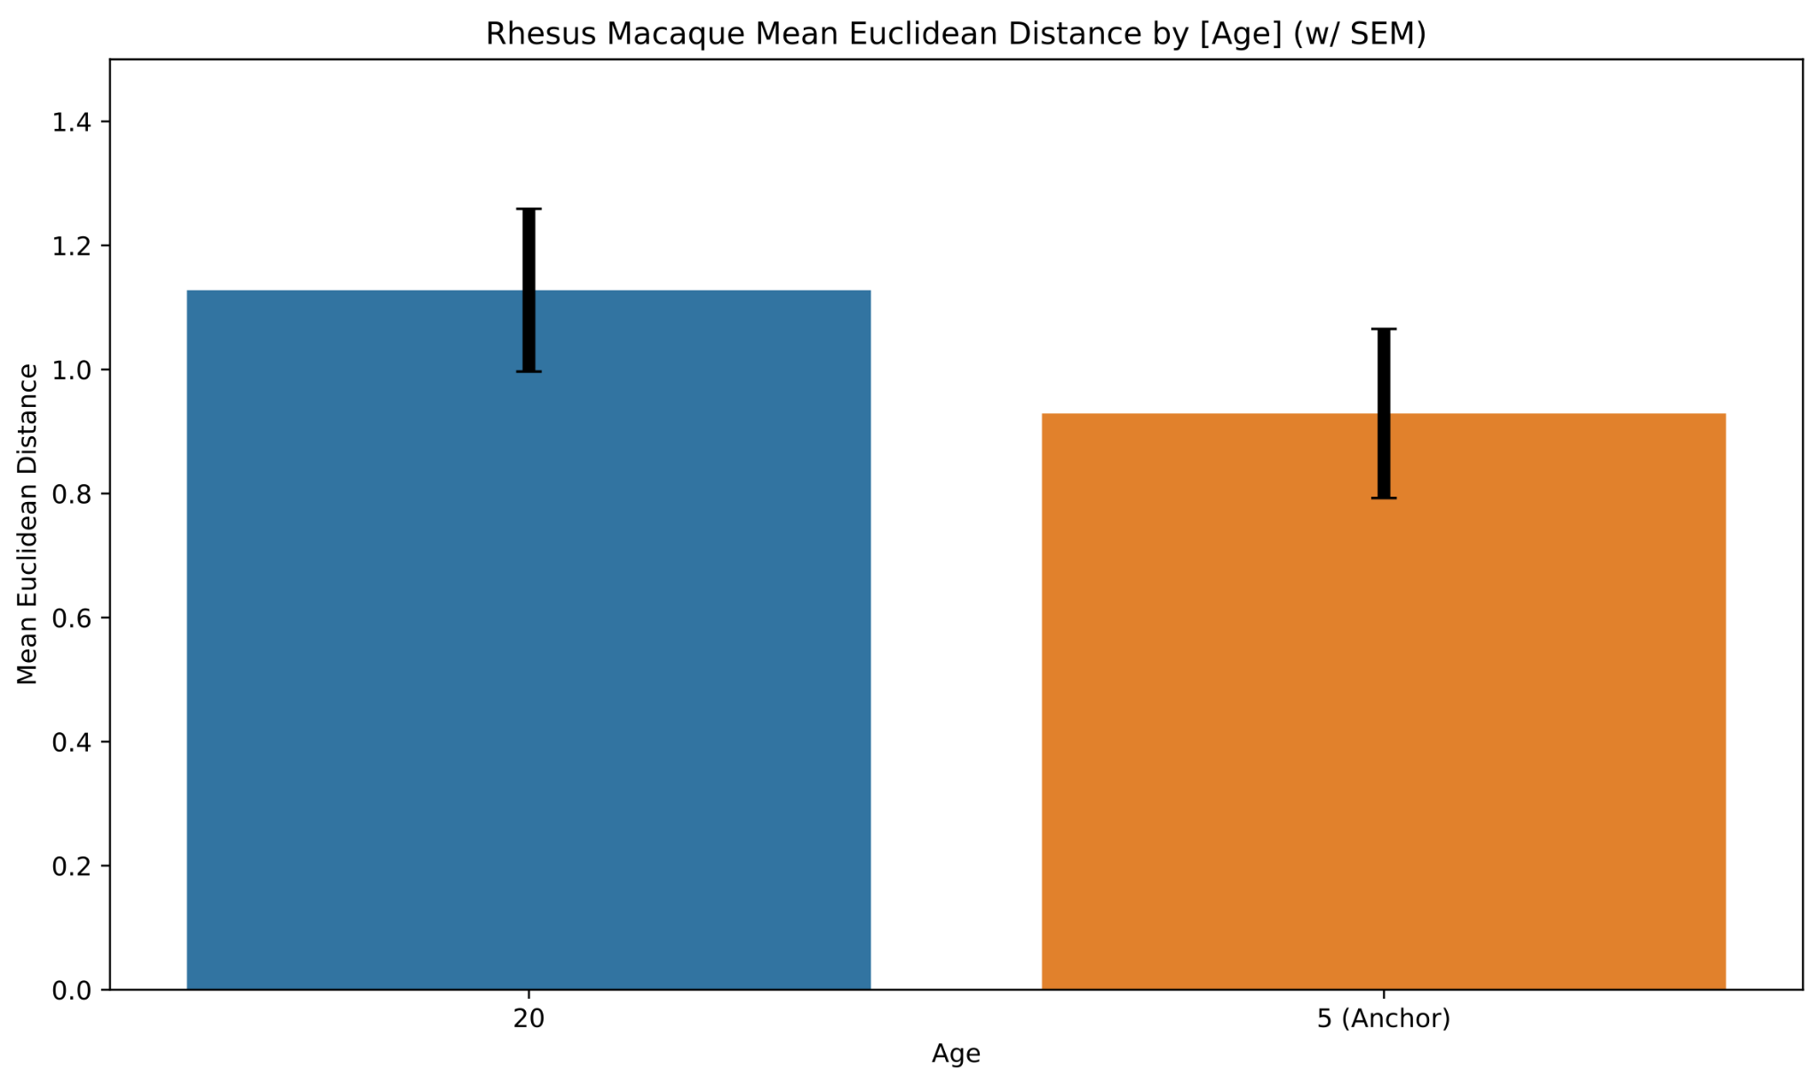
NS

Slide 23
Question 4
Can FaceNet discriminate across species? (Chimps vs Rhesus vs Jap. Monkey)

Slide 24
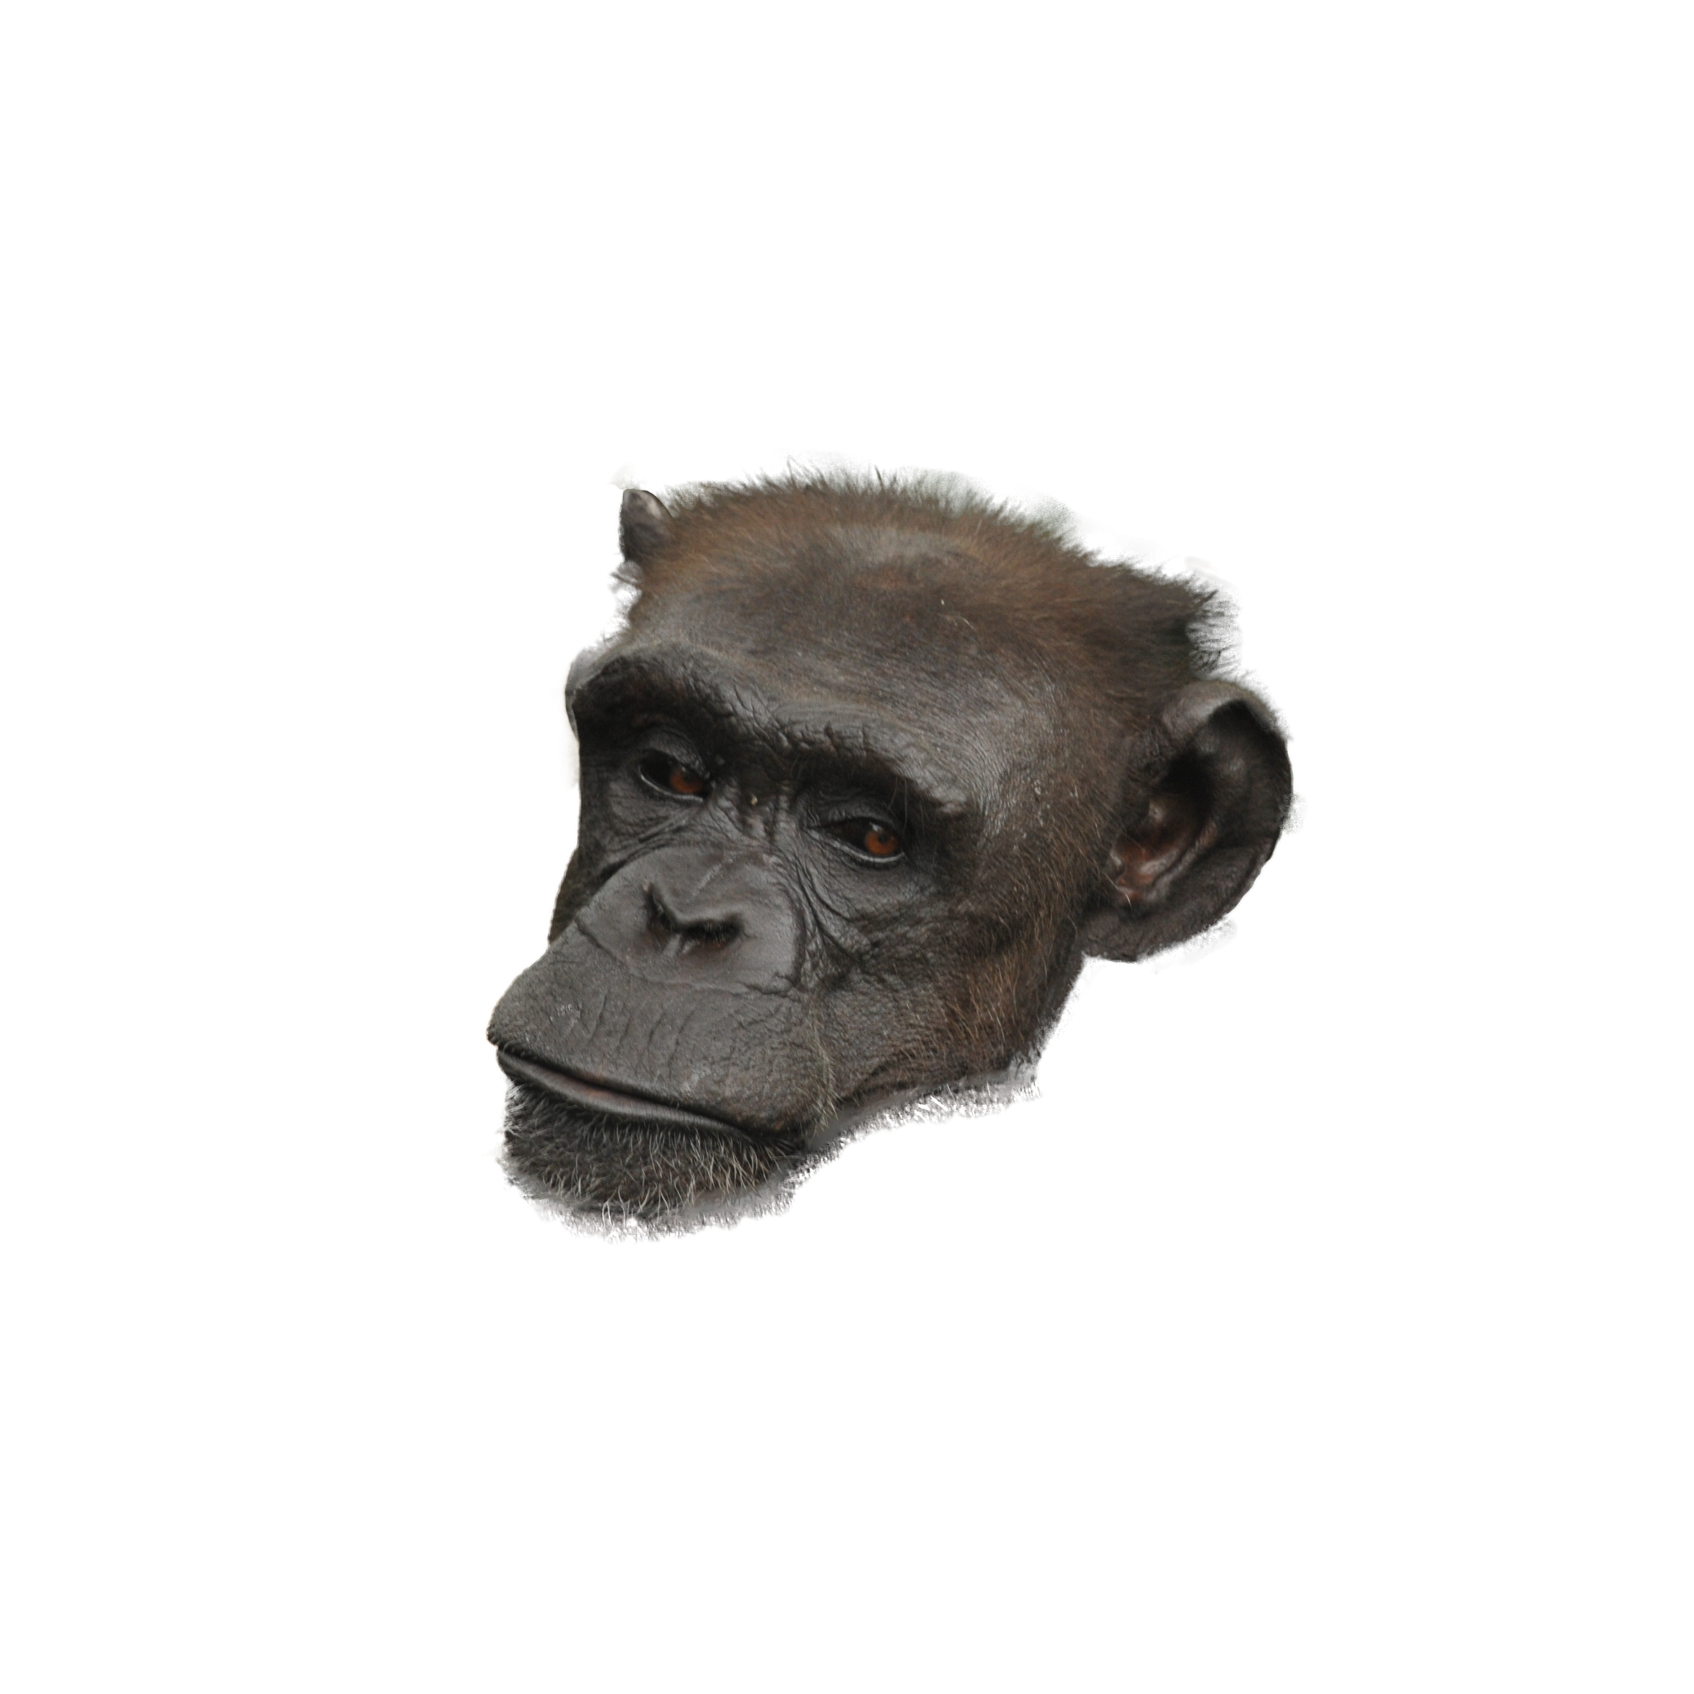
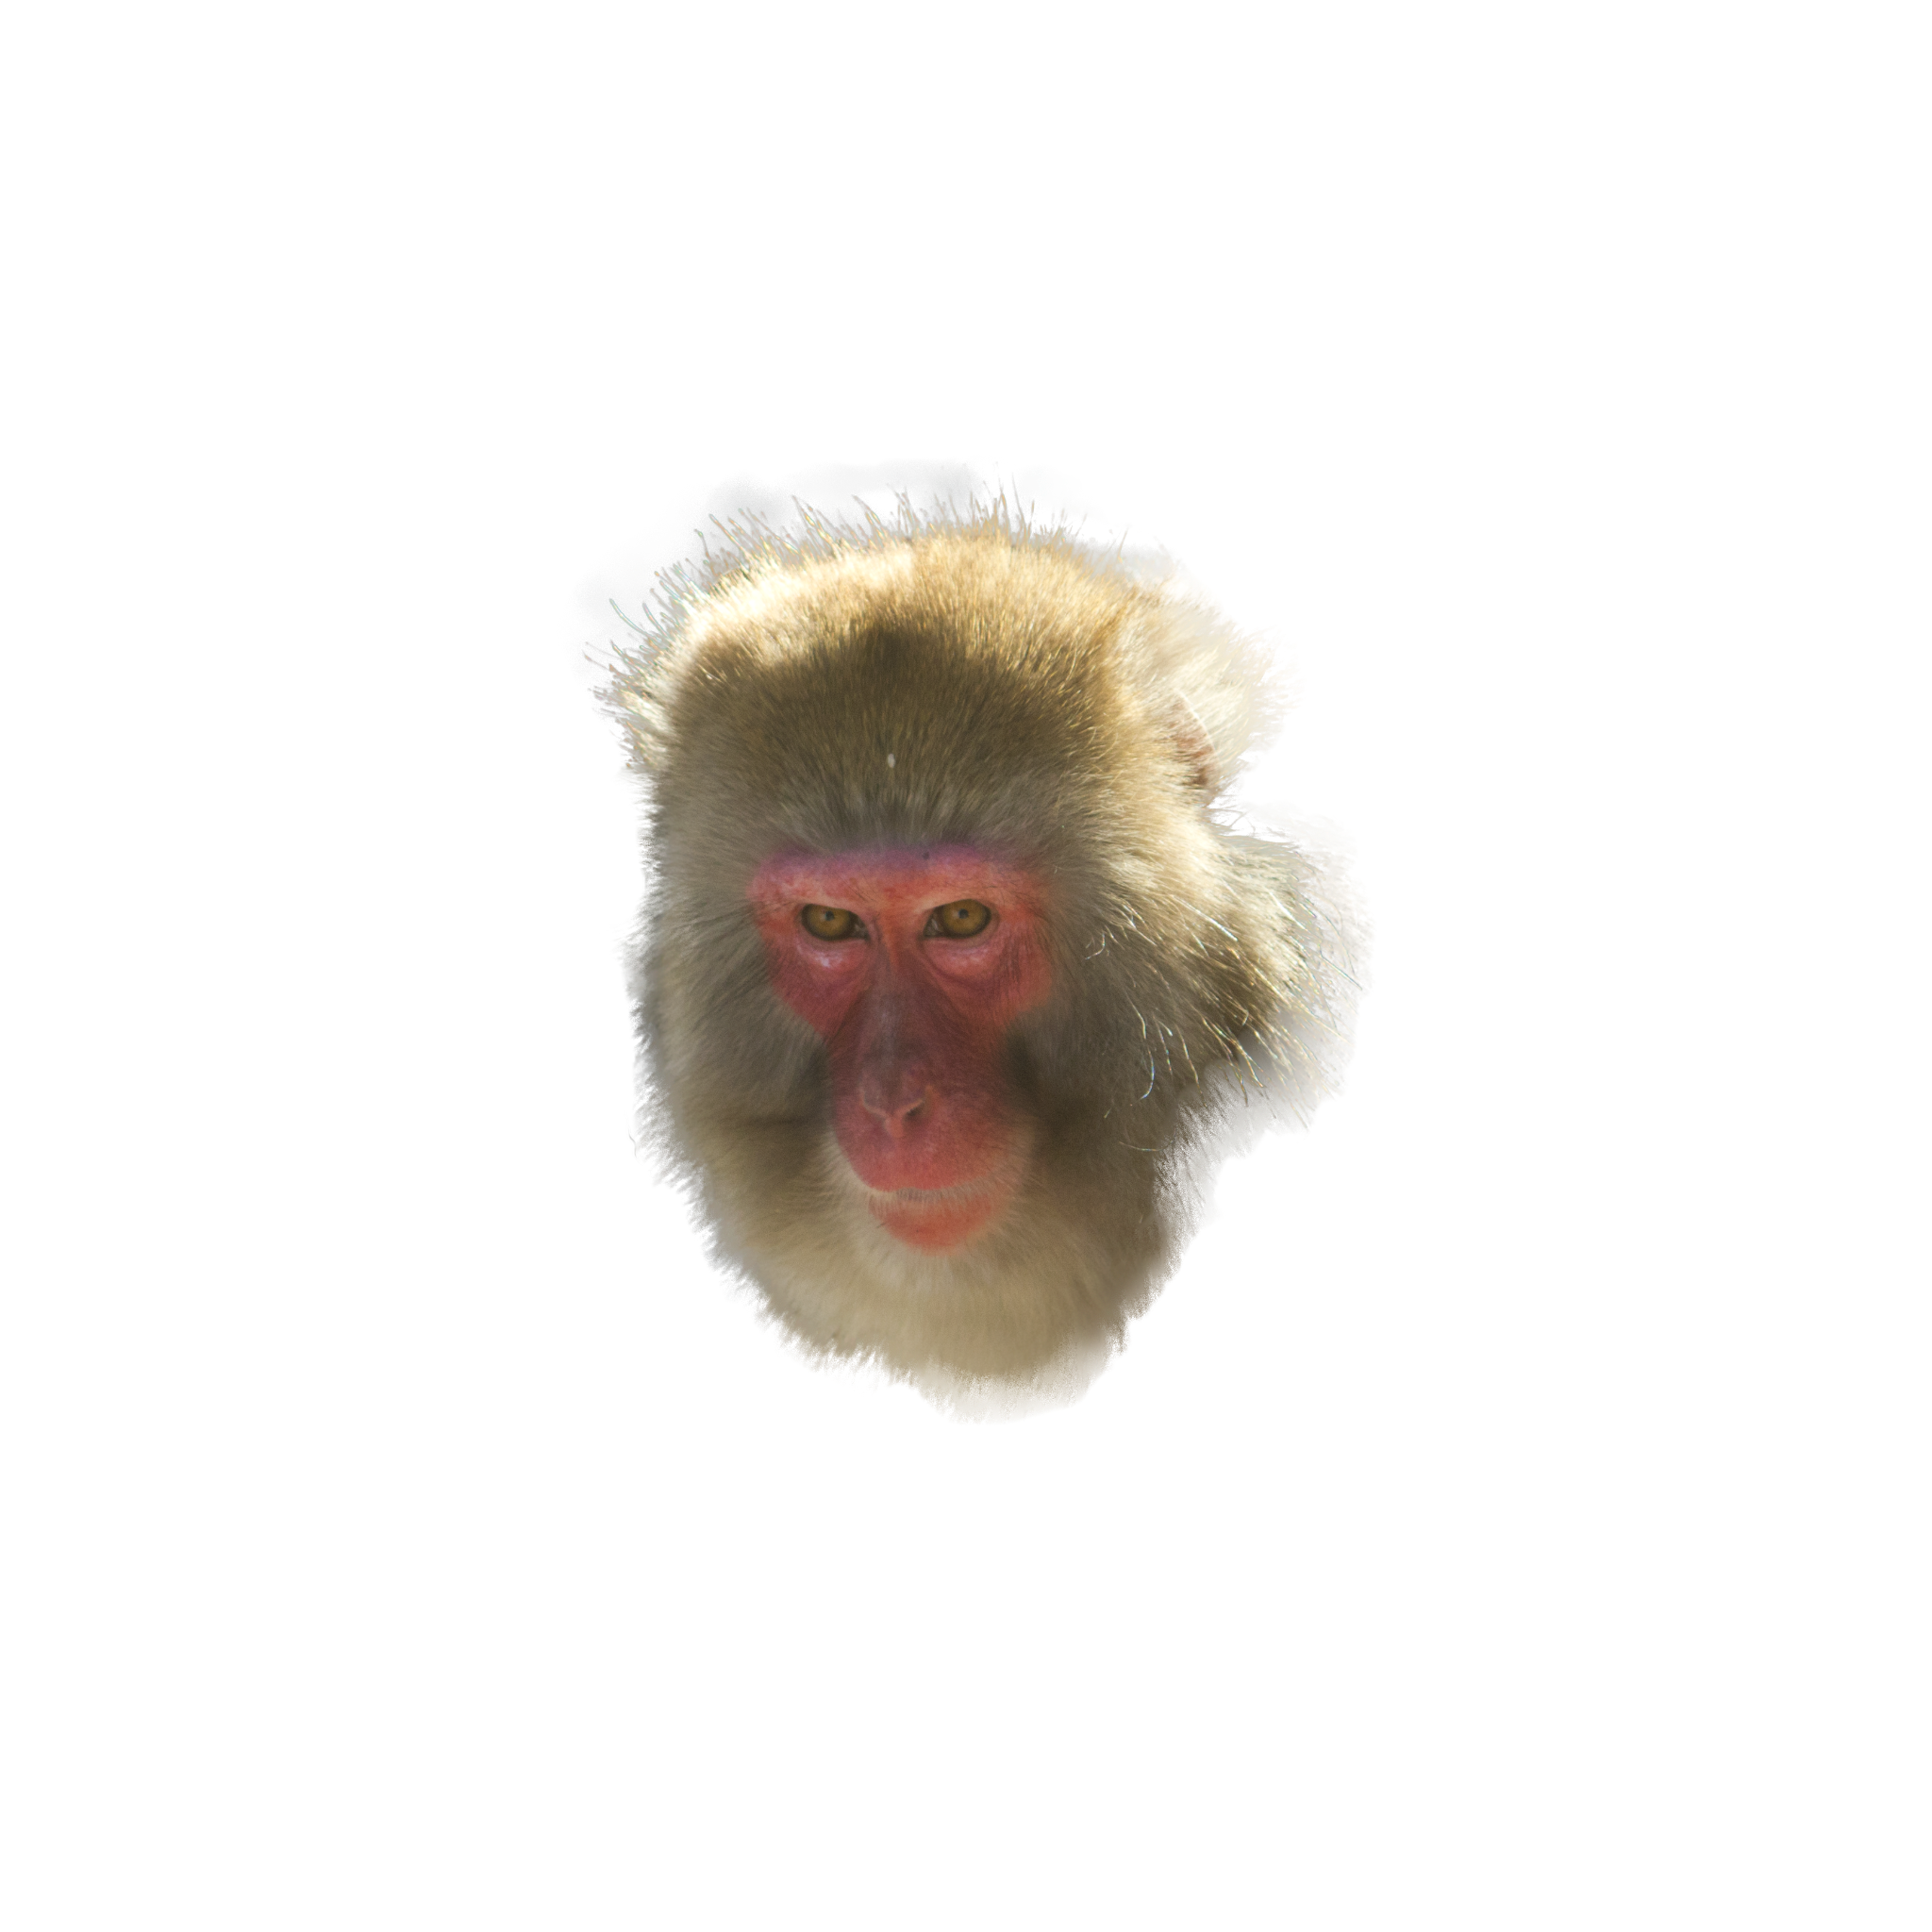
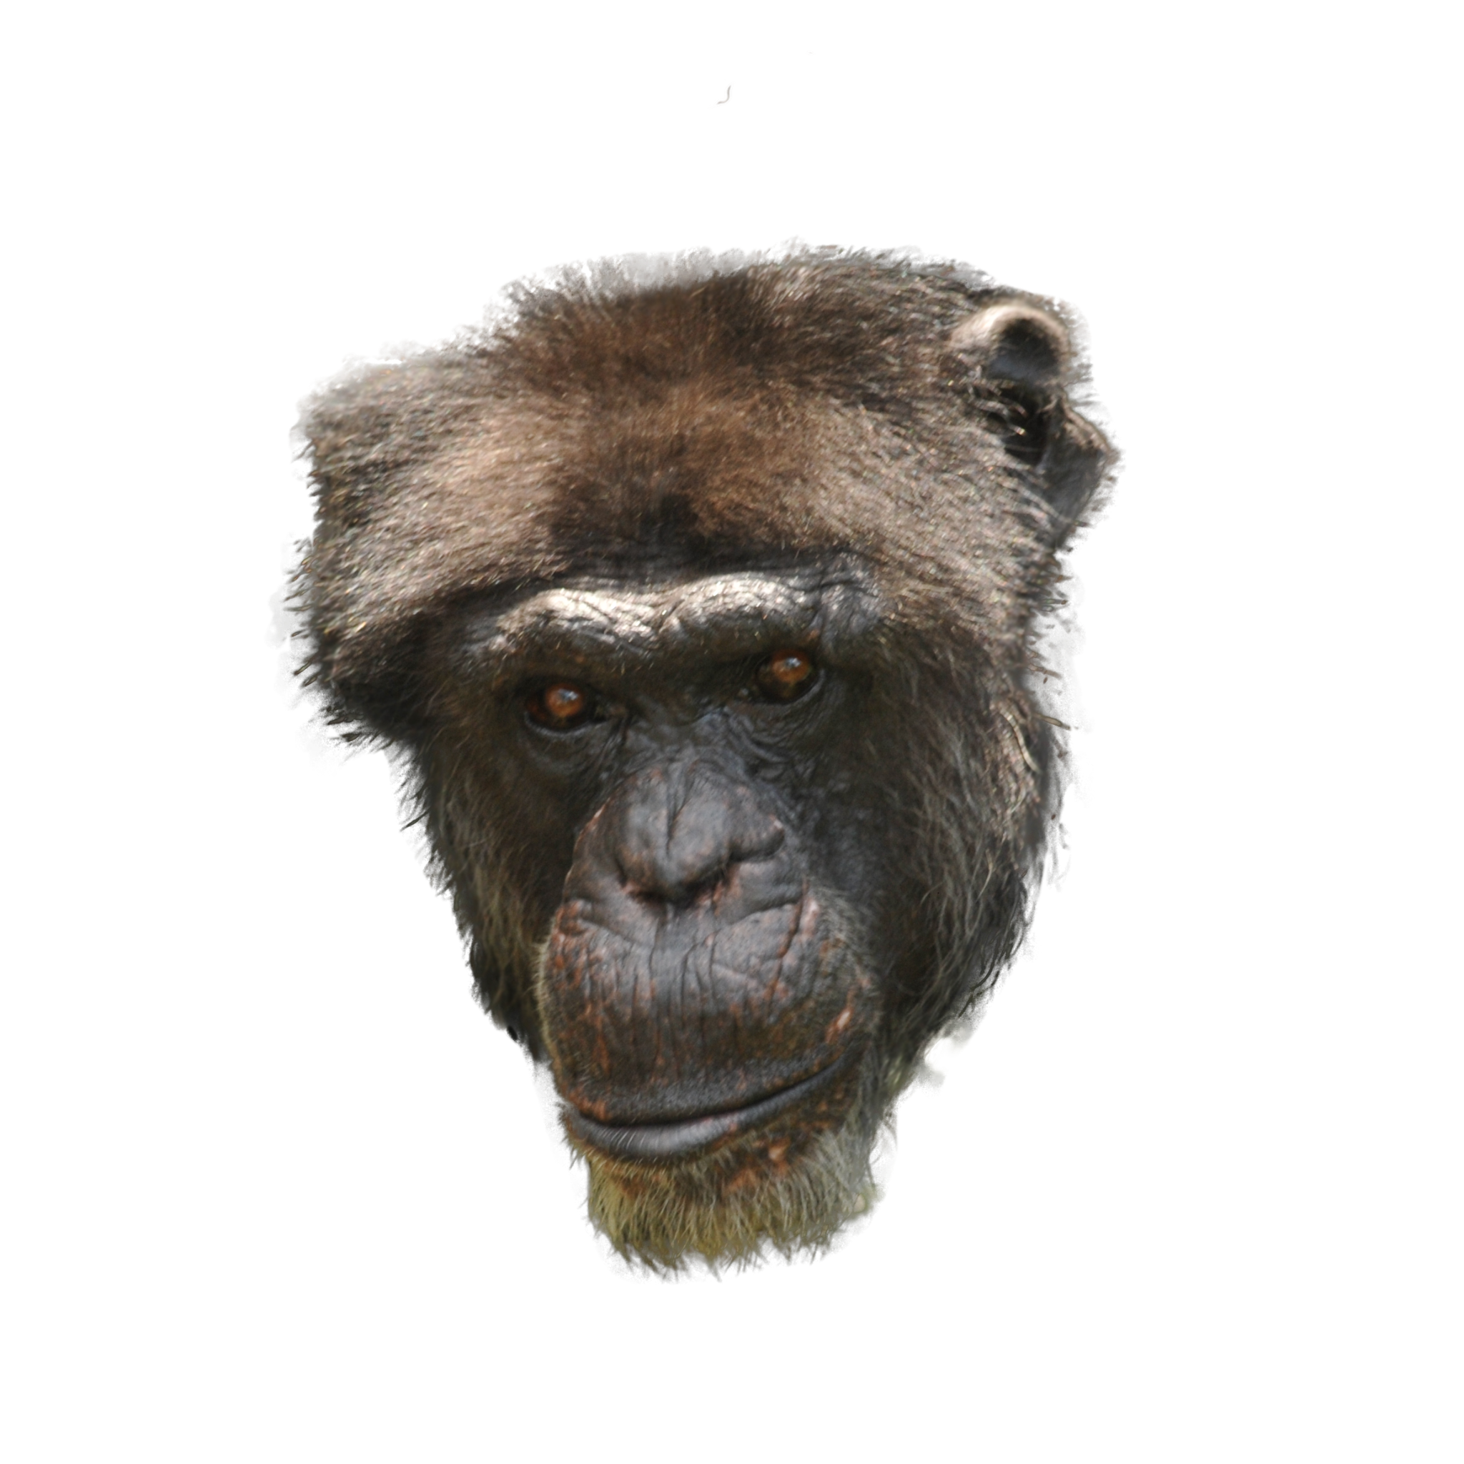
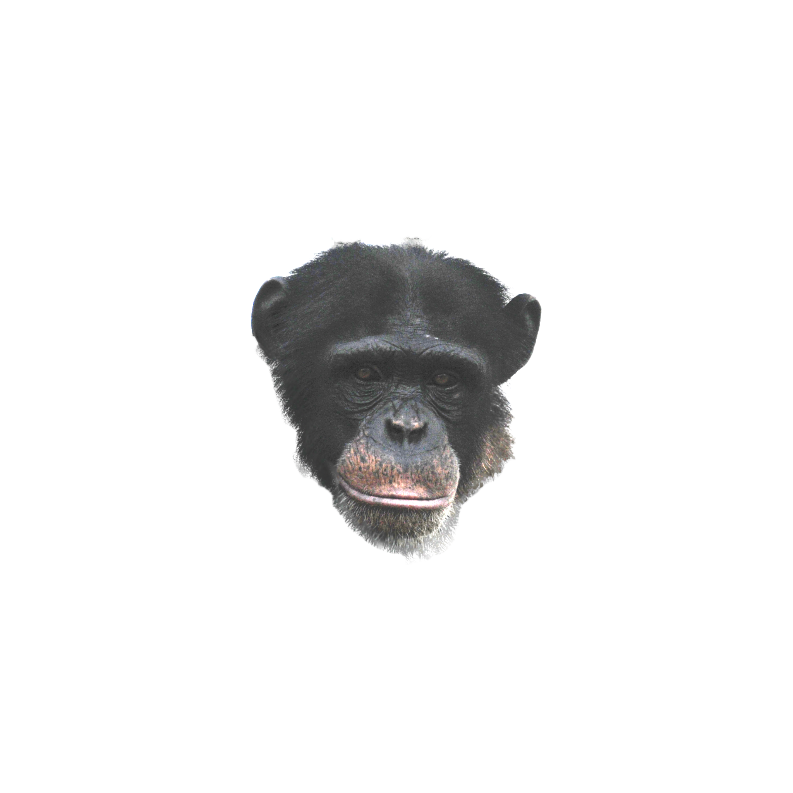
Negative/Positive/Anchor Images
Anchor:
Chimpanzee
(Female/Age:34)
Positive:
30 Images of 3 Chimpanzees
Negative:
30 Images of 3 Rhesus Macaques,
30 Images of Japanese Monkeys

Slide 25
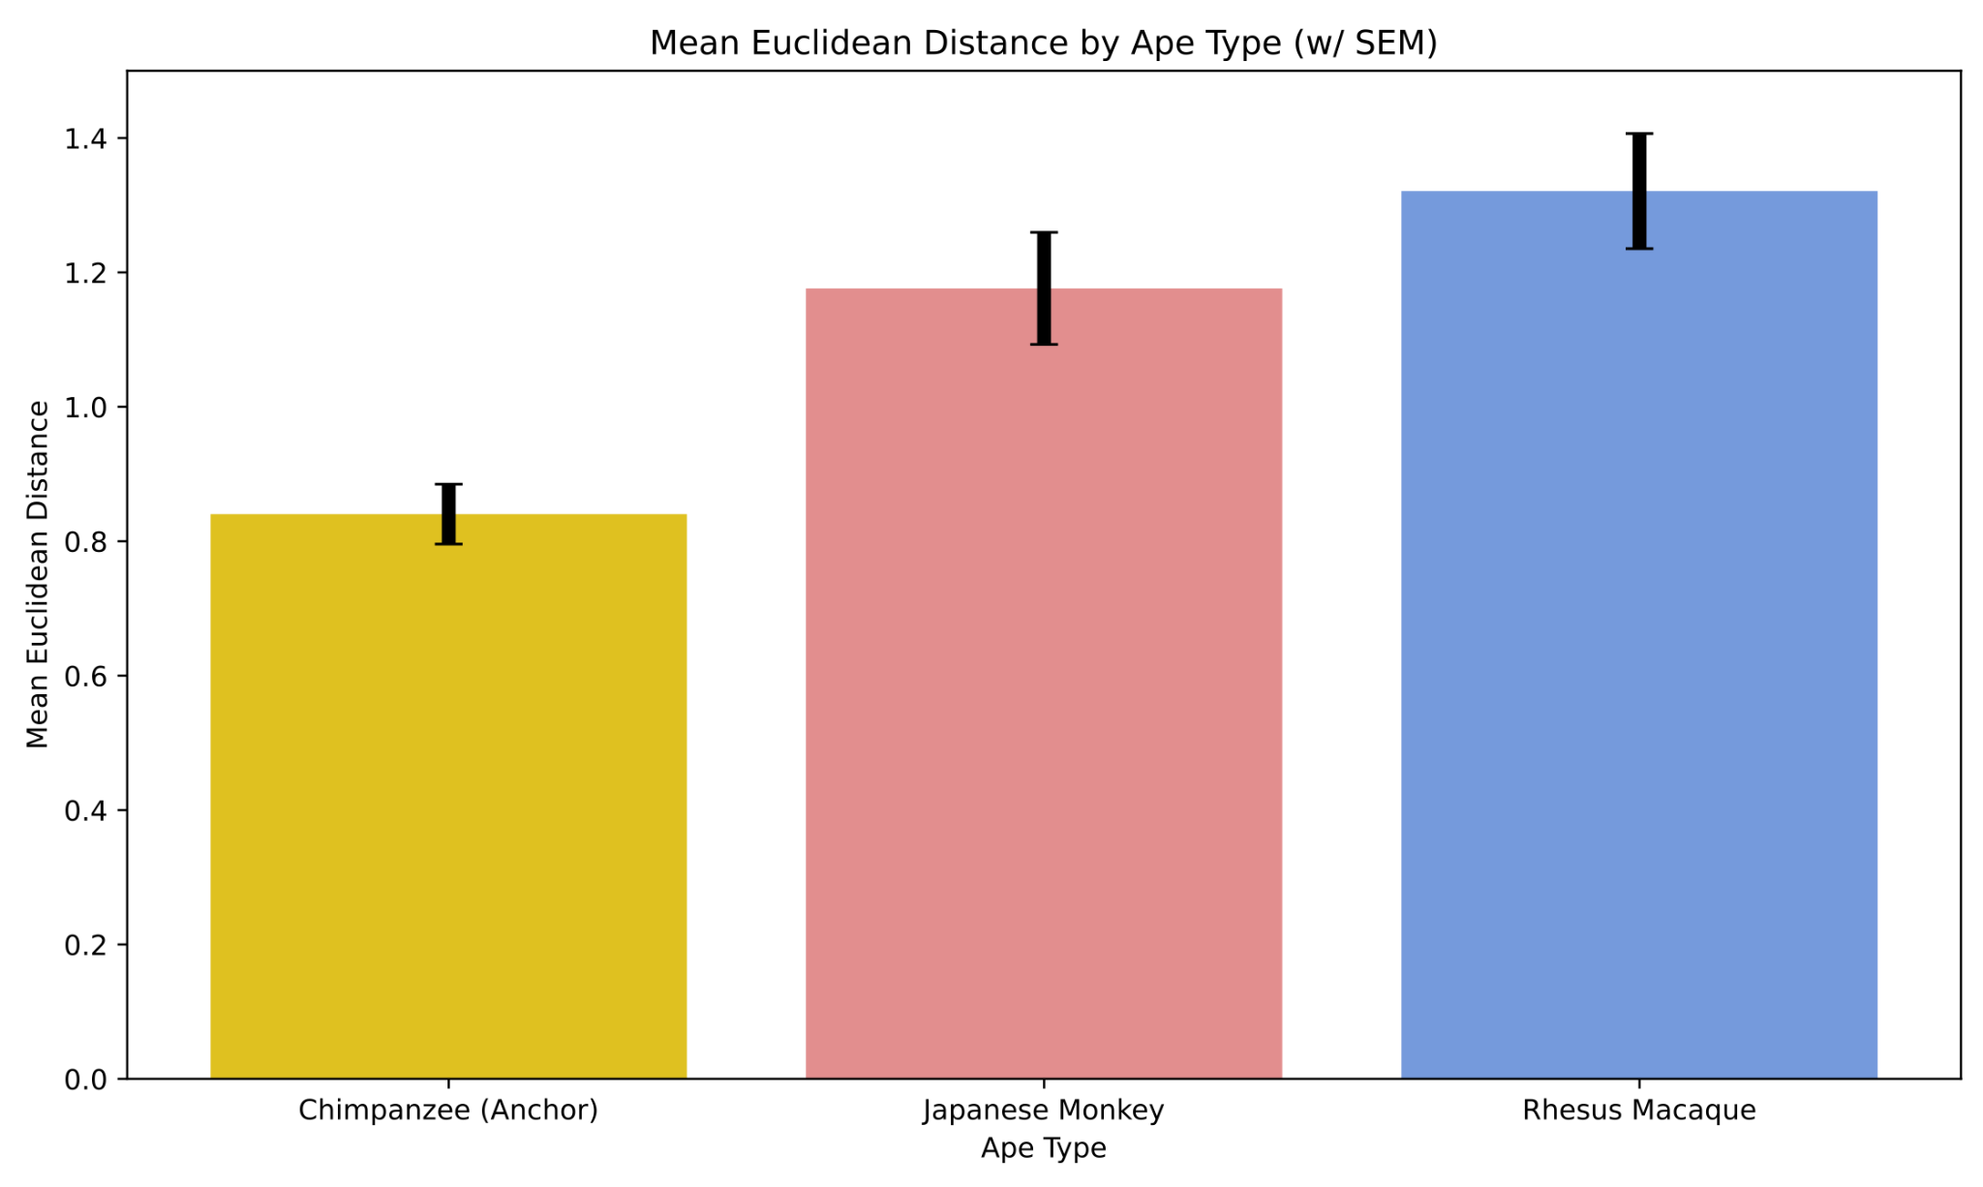
Can FaceNet distinguish Ape Types?
P < 8e-6
P = 0.00086
Notes:
Two sample t-test result
Chimpanzee vs Japanese Monkey: -3.5172920884660357 0.0008633154507542143
Chimpanzee vs Rhesus Macaque: -4.929759063223899 7.463368054808838e-06
Japanese Monkey vs Rhesus Macaque: -1.2115028941462302 0.2306156237544774

Slide 26
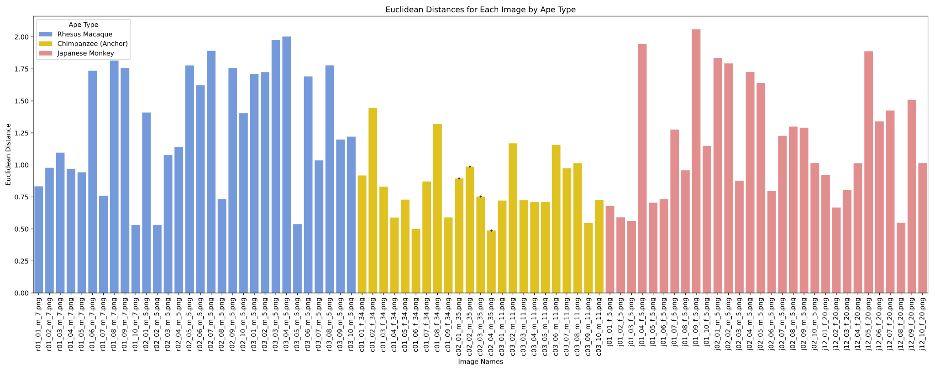
Can FaceNet distinguish Ape Types?

Slide 27
Conclusion

Slide 28
Q&A
thank you for your time and attention!

